Slide 1
Japanese culture and their sense of quality
Confidential
Only IBSV, IBSO
2014/10/1
IBS Okinawa

Slide 2
Purpose of this Document
This document is a reference for training on quality in global team.

Slide 3
Overview
1. Understand the purpose
2. Japanese culture
2.1. Service in Japan
2.2. Sense of Japanese
3. Quality in System Development
3.1. Point
3.2. If a failure occurs
4. Summary

Slide 4
Understand the purpose

Slide 5
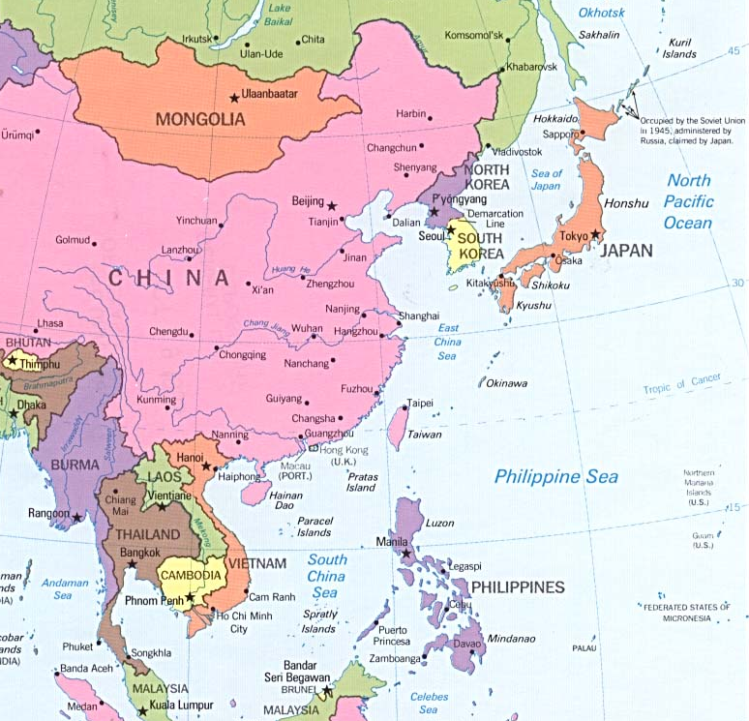


Who is customer?
Japanese *Immediate future

Slide 6
Evaluation
Complete following formula
?
?
Evaluation =

Slide 7
Evaluation
Complete following formula
Performance
Expectation
Evaluation =
Even if our Performance is very high , if not matched expectations evaluation is low.
To understand “Expectation” is very important.

Slide 8
If your evaluation is raised
If your evaluation is raised , chairman assign you high position.
As a consequence you can raised your wedge.

Slide 9
Summary of section
Purpose of this training
To get high evaluation is need to understand expectation of customer.
Let's learn a sense of customer and customer’s culture.
Let‘s understand Japanese culture and customer’s expectation.

Slide 10
Japanese culture

Slide 11
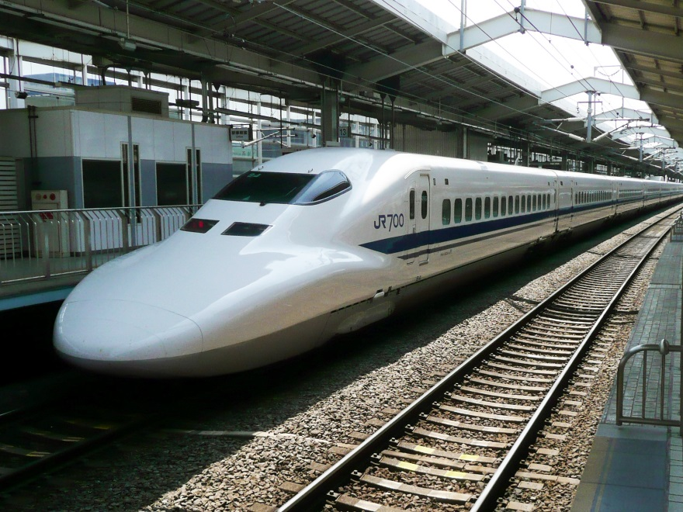
Service in Japan Train operate punctually
Japanese railways are among the most punctual in the world. The average delay on the Tokaido Shinkansen in fiscal 2006 was only 0.3 minutes.
Punctual is common in Japan.

Slide 12
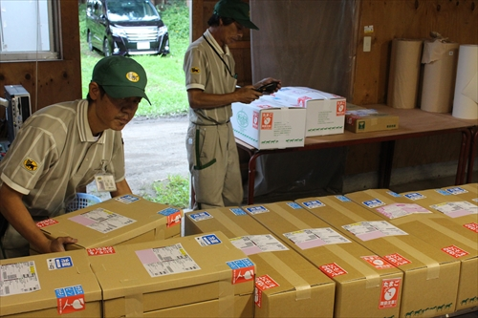
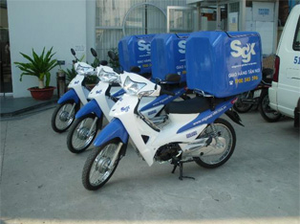
Service in Japan Door-to-door service
They can specify the time of the courier service in Japan.
Be lost luggage or stolen are very rare.
Services of high reliability is common in Japan.

Slide 13
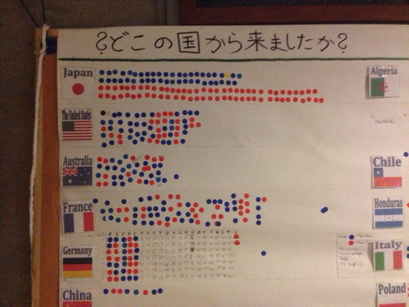
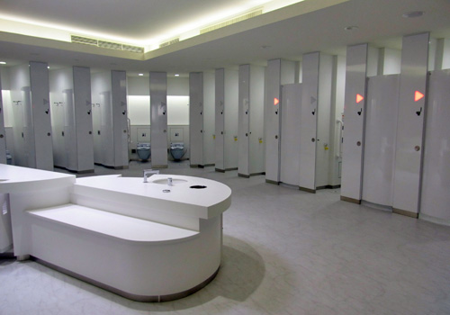
Sense of Japanese Keeping things tidy and things in order
Where are you form?
Japanese likes to sort out.
Town, road, office, and toilet are clean and organized.
Keeping things tidy and in order is common in Japan.

Slide 14
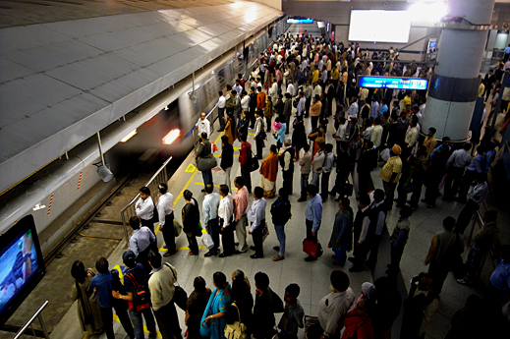
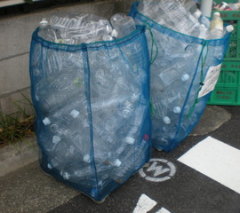
Sense of Japanese Keep the rules
They align even crowded.
They put away plastic bottles to trash after they washing it and removing labels from it.
To keep the rules that it was decided is common in Japan.

Slide 15
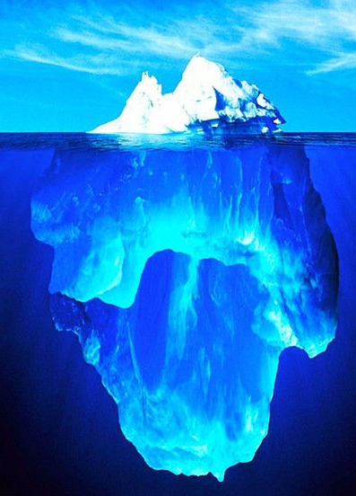


Sense of Japanese Sense of "The tip of an iceberg"
When our customer find a failure, they think
“Are there any failure similar to the other?”
Sight
There was only one validation bug!
It's easy fix!
Engineer
Hmm.
Are there similar bugs?
Are other screens no problem?
Customer
It is important for us to find one failure.

Slide 16
Sense of Japanese They make a claim by little
This tab order is incorrect!
Why does input mode change automatically?
Text box maxlength is too long!
Customer
This screen is very slow sometimes. How often? 1 per 100 times.
Customers in Japan are surrounded by high quality.
Therefore, they sometimes makes claim by small.
You should not feel like they are finding fault.
It's might be a matter of course for them.

Slide 17

Sense of Japanese Stop using it without claim
1
2
I must prioritize.
I must communicate with engineer.
I must……….
It’s troublesome!!!
I won’t know the screen!
There are many failure in the screen.
3
4
My screen was no longer needed. And I lost my job.
Engineer
Customer need energy to also say the claims.
Some customers are reluctant to say the claims.
What will they do to action? Just he will stop using it.
That the function you made with a lot of thought might be not used at all.

Slide 18
Sense of Japanese Read between the line
In addition to the search item on this screen
(I also added a screen similar to the other)
I want you to add one item to the screen
(It is the target of the free word search as well as other items)
Customer
I want you to put a sorting function in this table
(Performance Do not degrade)
Japanese guesses customers‘ thought and feelings. Sometimes specifications and request is ambiguous for that.
It becomes a source of trouble even in Japanese.
Rather than to interpret on their own, we should be checked.

Slide 19
Quality in System Development

Slide 20
Point

Slide 21
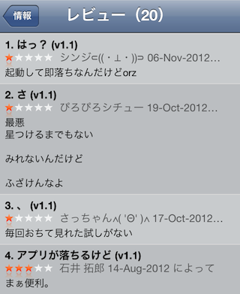
Point They don't like there are bugs.
App store review in Japan
Discovery of bugs is not the job of the customer.
Their job are to conduct business using the system and to obtain a profit.
So customer's expectations is that there is no bug.
It is difficult to do so, but we should try to do it.
This soft is free.
Reviewer didn’t pay any money.
But strict review.

Slide 22
Point They don't like objects are not aligned.
To align as much as possible where you align.
Are these
objects
aligned
neatly?

Slide 23
Point They don't like objects are not aligned.
To align as much as possible where you align.
Customers don’t like this!
Are these
objects
aligned
neatly?
Customers don’t like this!
We are professionals,
so we should note also in fine design.
As the saying goes “God is in the details”.

Slide 24
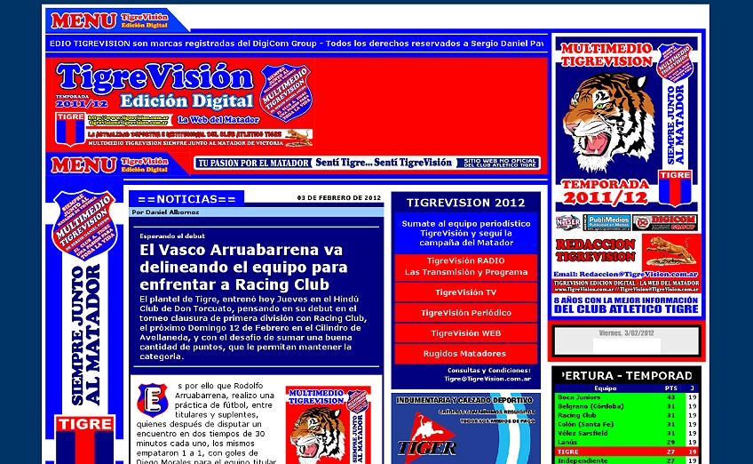
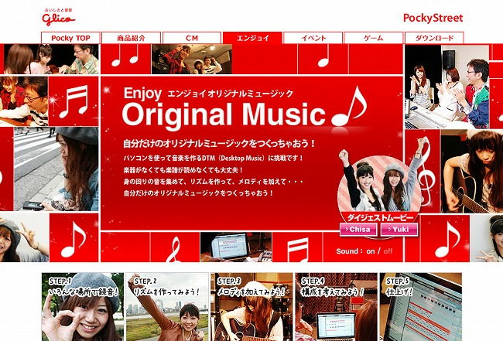
Point They like pale color
Web site from hell
Good design
Dark colors and primary colors hard to see.
You should not increase the color on its own.
It should not be decided by your taste.
Be followed if there is a guideline of UI / UX is important.

Slide 25
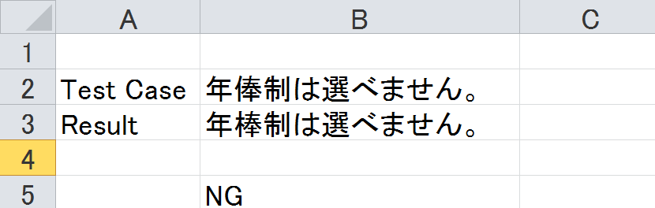
Point They are particular about a detailed message.
Message in Test Case
「年俸制は選べません。」
This message is probably correct.
Maybe. I'm fine?
This case is OK!
Result Test
「年棒制は選べません。」
VN Engineer
I don’t know Japanese.
I’ll compare result to test case by Excel.
Oh, it’s NG!
I’ll make a ticket.
VN Engineer
=IF(B2=B3,"OK","NG")
It is difficult test of the error message because the comparison of the Japanese. Design test is difficult, too.
Let's compare it to devise a way to test the design and message.

Slide 26
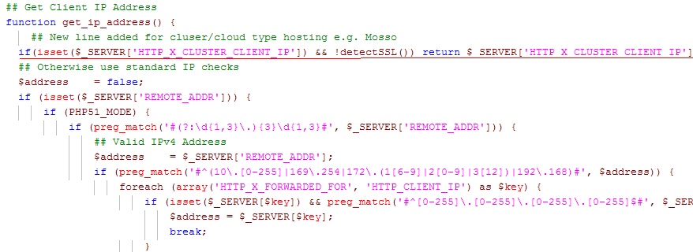
Point They don't like readability of the source is low
Source code is creature.
Another person touch tomorrow.
We should write the code easy for me one month after.
And we have to add comments beside coding.
It make other member can be easy to understand.

Slide 27
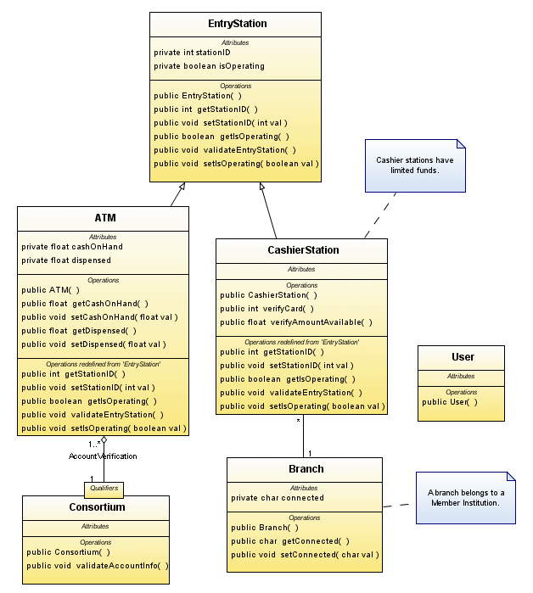
Point They don't like the source is not adjustable
Source also changed the business is changed.
Do not get just move.
We should write the source is divided into classes and methods in the appropriate.

Slide 28
Point They don't like performance is slow
In many cases performance test is carried out in parallel with the ST or IT.
Coding
UT
IT
ST
Performance
Test
We have to fix and retest.
If we find a location where there is a problem with the performance.
In some projects SQL was the cause of performance degradation.
Are you care about the cost of SQL?

Slide 29
If a failure occurs

Slide 30





Send email wrong
This is a real episode. A web site was launched.
However, the site was unstable.
Customer no longer could a business smoothly.
I’ll release new Site!
I can’t access
I never use this service!
Engineer
Noooooo!!!
I’m terrible sorry!!!
My writing data is lost!
Customer
Customer’s
Customer
As a result, customer was a loss of several hundreds of thousand dollars.
We also lost customer confidence.

Slide 31
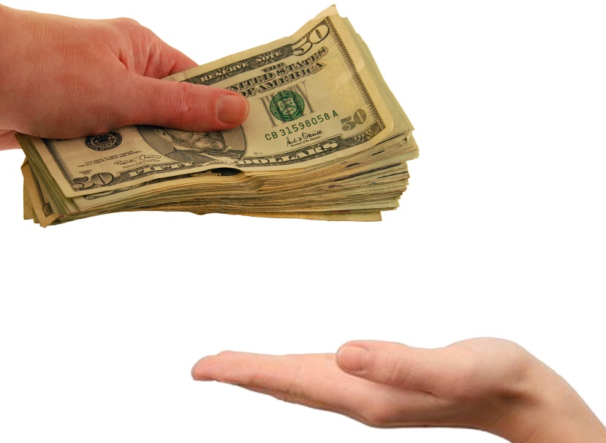
Refund
If our system doesn’t meet the demands of the customer, we must return the money to customers.
It is not only function in the request.
The request is also included non-functional requirements (for ex performance ).

Slide 32


Compensation for damages
In 2006, Mizuho Securities sued by cancellation process did not perform the Tokyo Stock Exchange.
In 2009, Tokyo District Court was sentenced to order payment of approximately 10.7 billion yen on the Tokyo Stock Exchange.
The cause was a bug in the cancellation process.
There is a possibility of damage to the customer by our bugs.
In that case, we have to compensation for damages to the customer.

Slide 33
Summary

Slide 34
Summary
We must understand the expectations in order to obtain a high evaluation.
Japanese customer are surrounded by high quality service, so they require high quality in System Development. It is their expectations.
If a failure occurs the customer's so annoying. We lose confidence easily.
In order to improve the evaluation of the customer, we must ultimately quality more.

Slide 35

OKINAWA

